Slide 1
Probabilistic Programming for Recommender Systems
Anusha Natarajan
April 2026

Slide 2
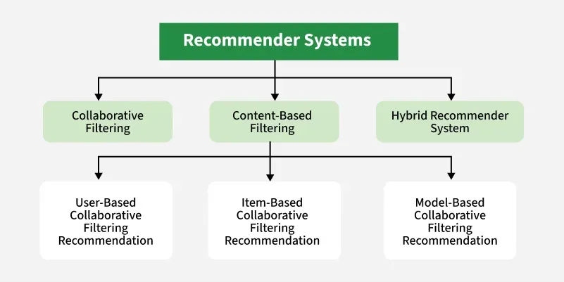

What are recommender systems?
Algorithms that predict what a user will find relevant — and surface it.

Slide 3
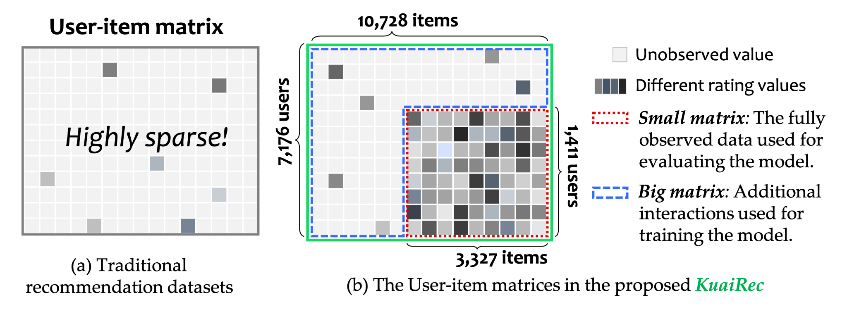
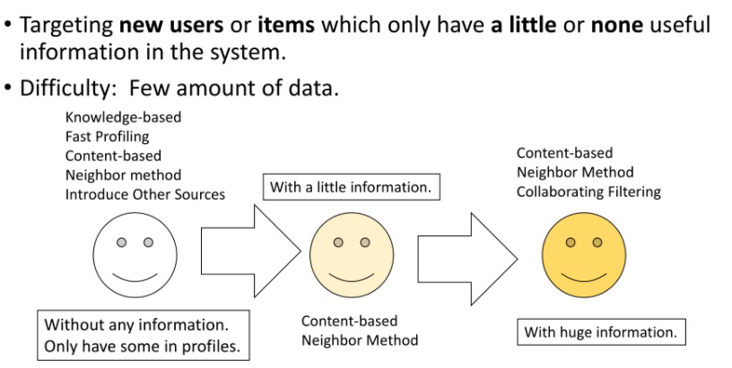
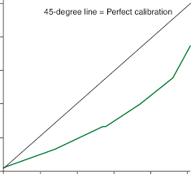
However there are challenges…
Cold Start
Sparse Data
Overconfident Predictions

Slide 4
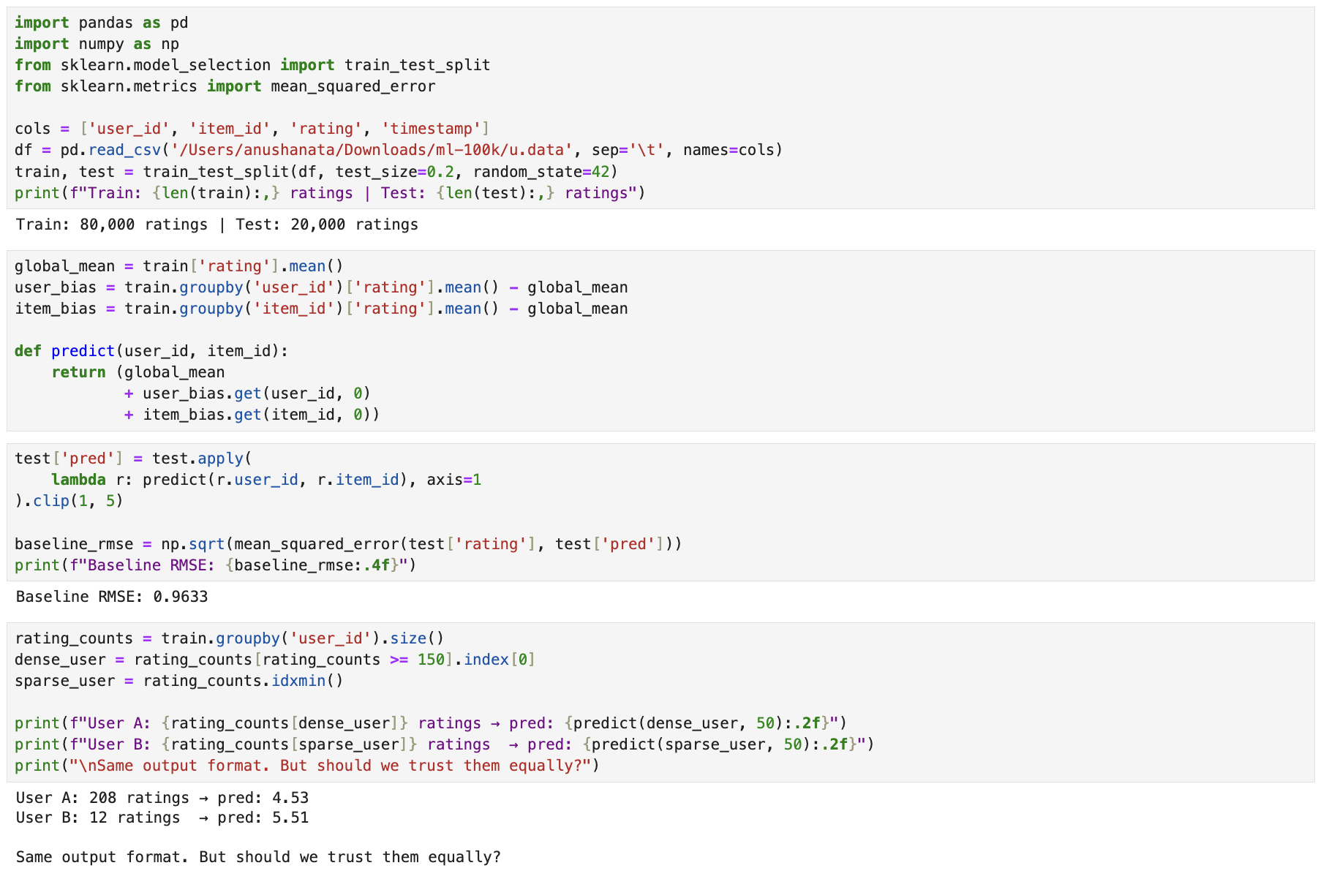
Sample Recommender System Implementation

Slide 5
Probabilistic Programming Concepts

Slide 6
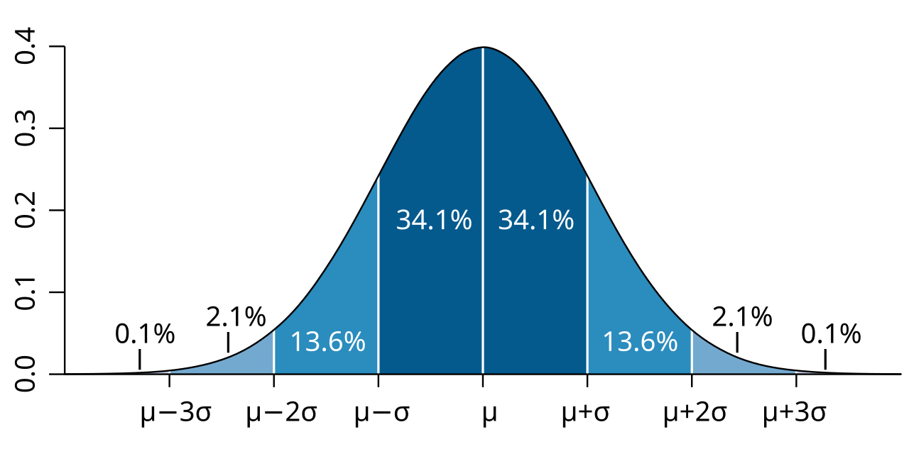
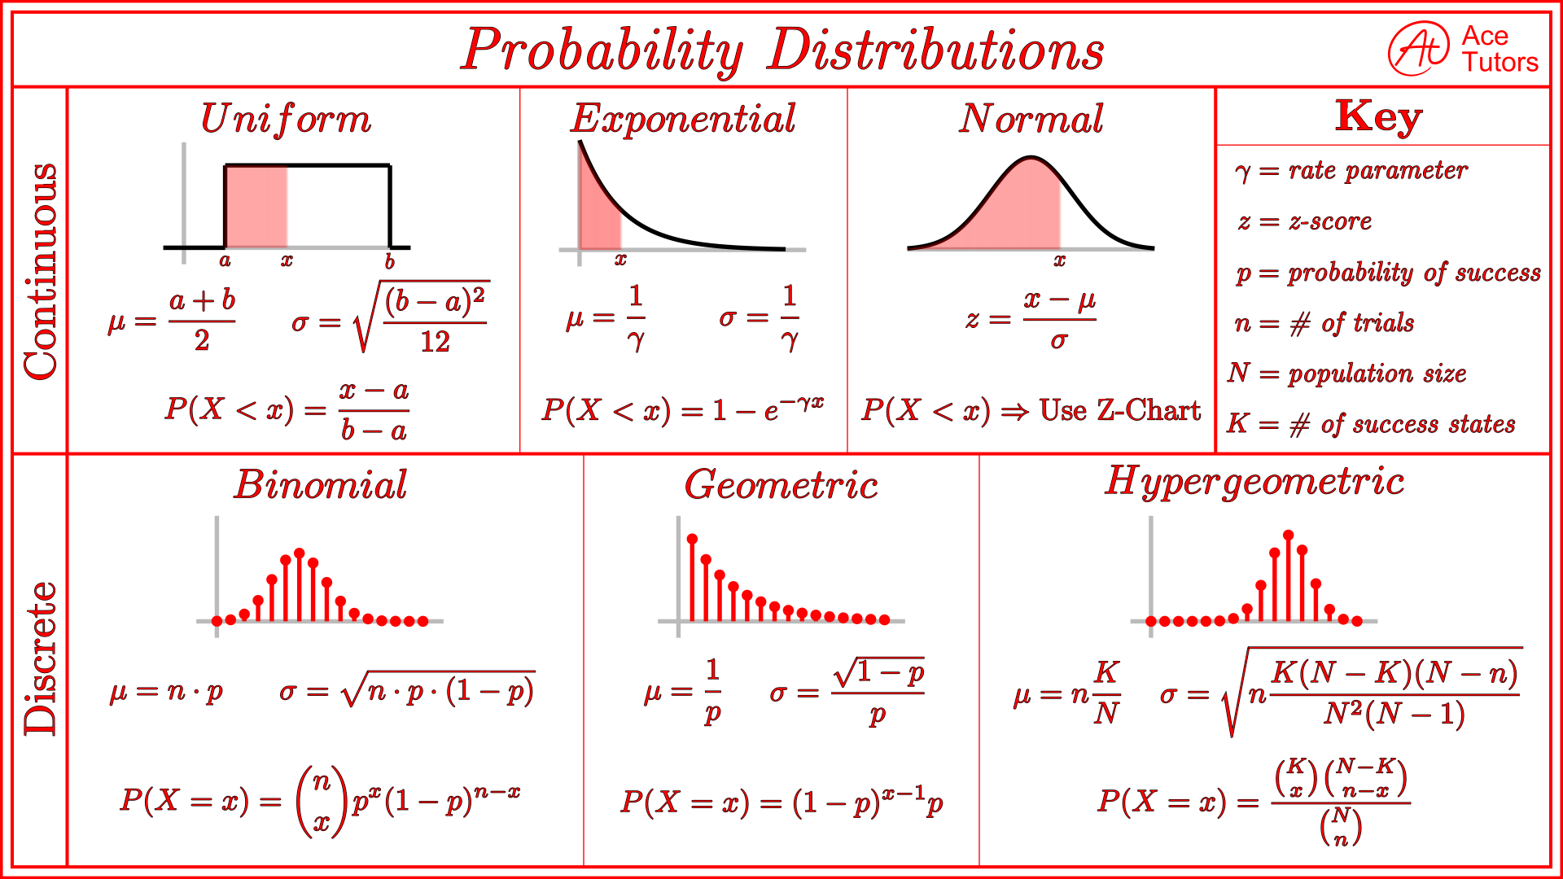
What is a Probability Distribution?
A probability distribution describes all the values a quantity could take, and how likely each one is.
Types
Uniform
Exponential
Normal
Binomial
Geometric
Poisson

Slide 7
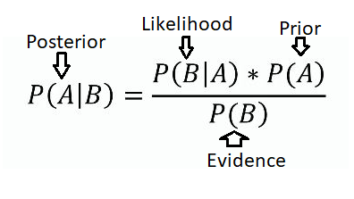
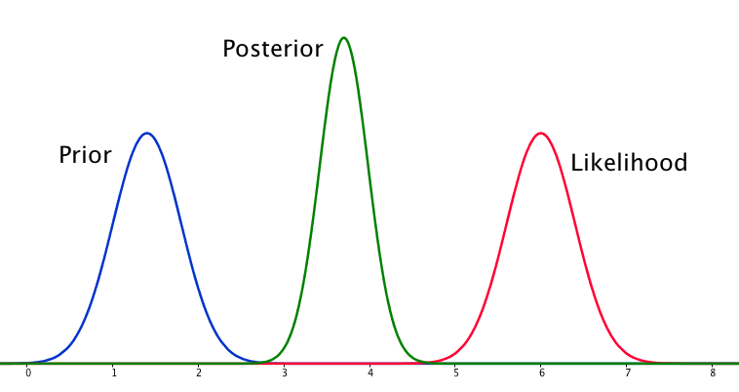
Prior, Likelihood, Posterior
Prior: initial belief about a parameter
Likelihood: the probability of observed data given that parameter
Posterior: updated belief after combining both using Bayes' theorem

Slide 8
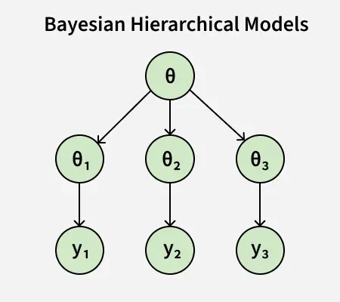
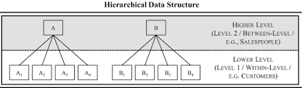
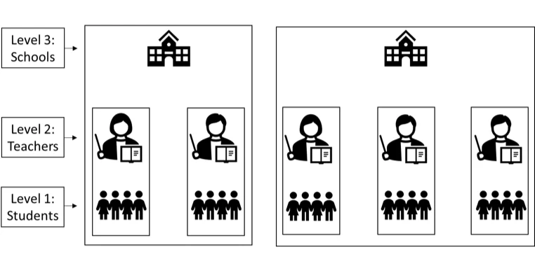
Hierarchical and Multilevel Modeling
Level 1 — Population: global mean rating
Level 2 — Group:user and item offsets
Level 3 — Observation: individual ratings

Slide 9
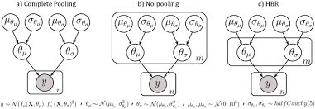
Partial Pooling
balances between estimating groups independently (no pooling) and combining them (complete pooling)
Shrinkage: Partial pooling reduces variance by pulling extreme estimates from small sample sizes toward the global average, which often reduces overall error.
Balanced Approach: It overcomes the over-fitting of "no pooling" and the under-fitting (ignoring group differences) of "complete pooling".
Hierarchy: It assumes that, while individual groups have unique characteristics, they are related, making it logical to share information across them.

Slide 10
Putting it Altogether
Hierarchical Modeling can be used in
Multi-Behavior Modeling — connects clicks, likes, and purchases to improve recommendations
Attention Networks — models short-term and long-term user preferences across timescales
Explicit & Implicit Hierarchies — uses category → subcategory → item structure
Incorporating Bayesian Stats into Hierarchical Modeling
Sparse Data — priors from broader categories stabilize predictions for new users and items
Cold Start — borrows strength from the population when individual history is thin
Scalability — variational inference (NumPyro, PyMC) makes it practical at production scale

Slide 11
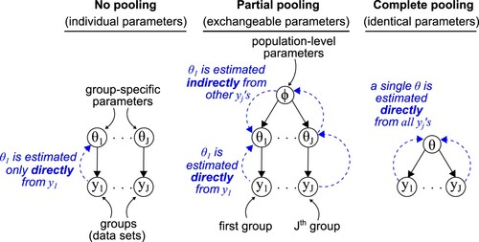

Slide 12
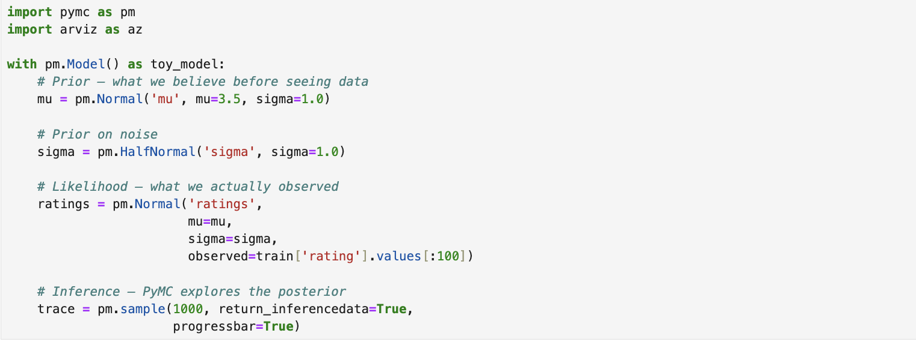
Tutorial of PyMC
PyMC is a probabilistic programming library for Python. It can be used for Bayesian statistical modeling and probabilistic machine learning. PyMC performs inference based on advanced Markov chain Monte Carlo and/or variational fitting algorithms.

Slide 13
The Model Equation
predicted_rating = global_mean + user_offset + item_offset

Slide 14
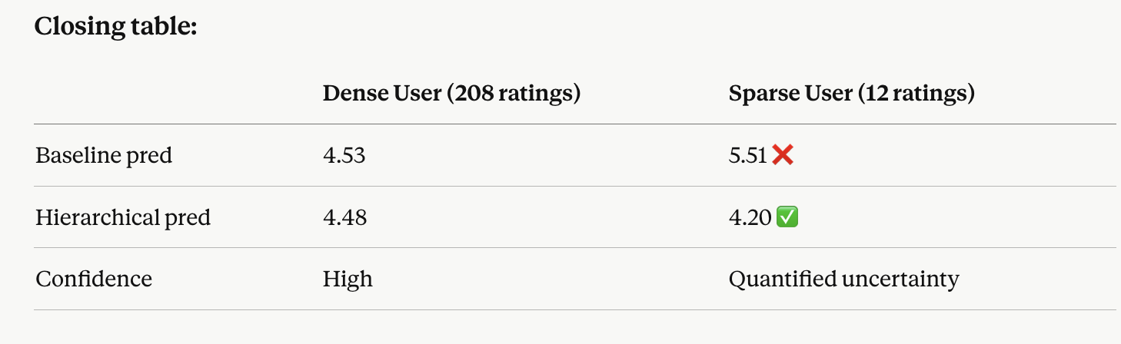
Evaluation & Results
Baseline RMSE: 1.1367
Hierarchical RMSE: 0.9457
Improvement: 0.1910 ✅

